Slide 1

CAR RENTAL RESERVATION SYSTEM
upGrad
GITHUBLINK: https://github.com/YUGANDERAN/final-python-project/tree/main
SUBMITTED BY,
Name: Yuganderan. G
Reg.no.:12310206
Roll no : 22
SUBMITTED TO,
Name: Mr.AmanKumar
UID:63642
Lovely Professional University

Slide 2
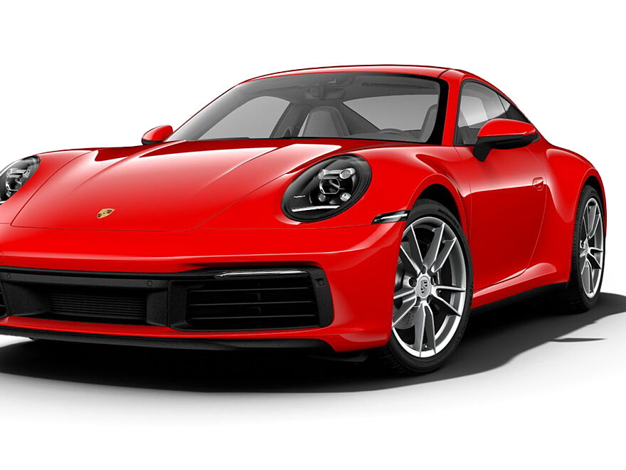
Introduction
The Car Rental Reservation System is designed to revolutionize car rental operations by automating booking, payments, and inventory management. It simplifies processes, enhances accuracy, and provides a scalable platform for both customers and admins.

Slide 3

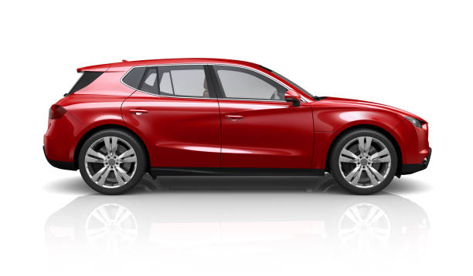
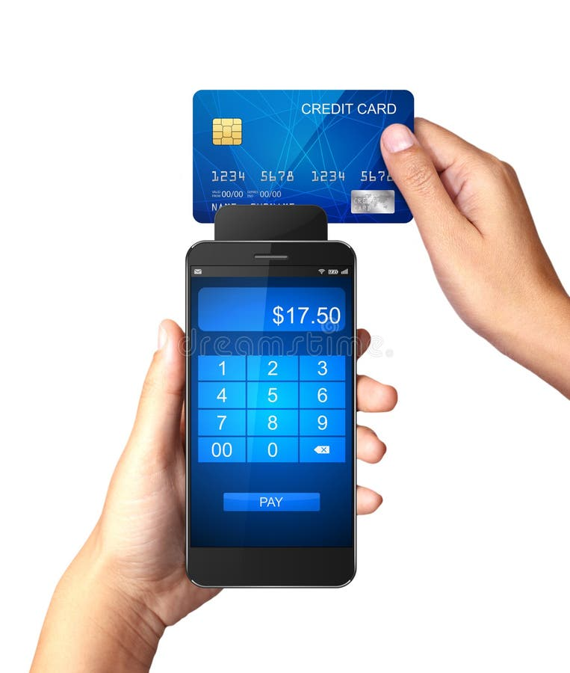
Objectives
1. Automate booking and reservation processes.
2. Ensure secure role-based access control.
3. Streamline vehicle inventory management.
4. Integrate payment processing with transaction confirmation.
5. Build a scalable and adaptive system.

Slide 4
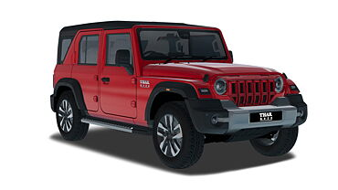
Scope
1. Admin Dashboard: Manage vehicles, customers, and bookings.
2. Customer Data Management: Create and update profiles.
3. Real-Time Availability: Track and update inventory.
4. Secure Database Integration: Use MySQL for data management.
5. Expandable Design: Ready for future upgrades like loyalty programs.

Slide 5
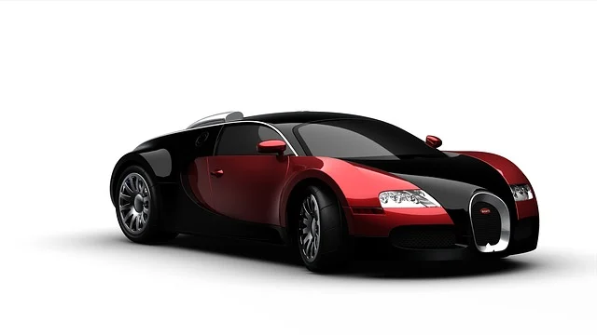
Tools and Libraries
Programming Language: Python
- Tkinter: For GUI
- MySQL Connector: For database operations
- Pillow: For images
- Subprocess: For modular design
Database Tools:
- MySQL Workbench and CLI
IDE: Python IDLE

Slide 6
Major Modules & Functionalities
1. Login Module: Secure access for admins.
2. Admin Module: Manage cars, customers, and payments.
3. Customer Module: Book, pay, and manage reservations.
4. Database Backend: Ensure data integrity with MySQL.

Slide 7
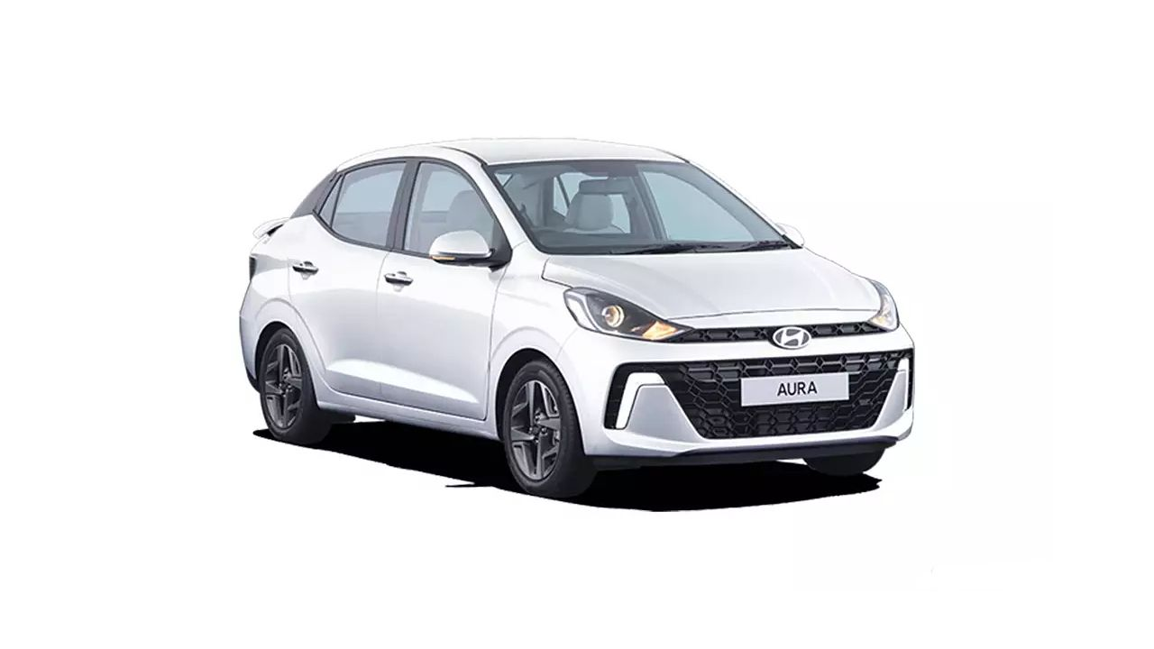
Future Enhancements
1. Loyalty Programs: Rewards for frequent users.
2. Mobile App Integration: Accessibility on-the-go.
3. Dynamic Pricing: Adjust rates based on demand.
4. AI-Based Support: Chatbots for instant help.
5. Real-Time GPS Tracking: Monitor car locations.

Slide 8
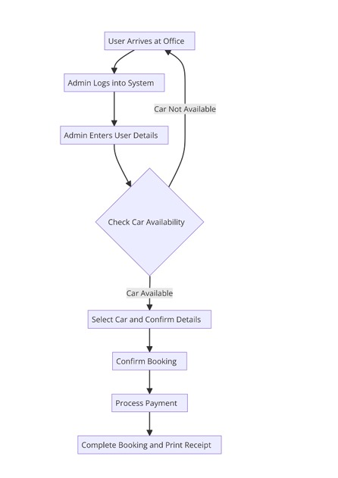
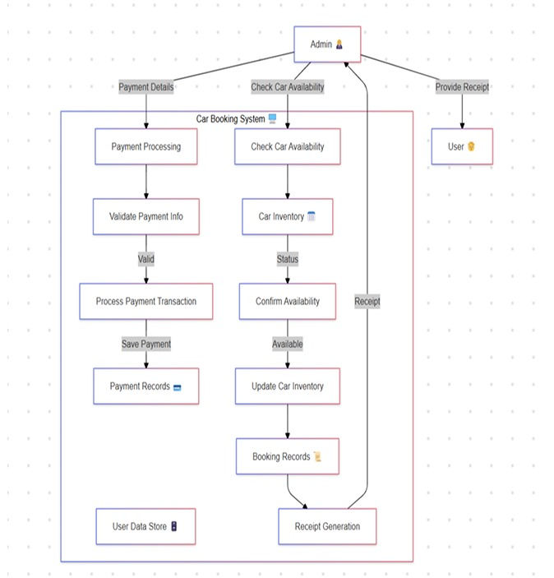
Flowchart – This depicts the details about all the functions from the top till the bottom last function. This includes both ADMIN and PAYMENT dashboards elaborated.
DFD – This briefly describes the way the data is stored in database and the skeletal description of how menu is accessed.

Slide 9
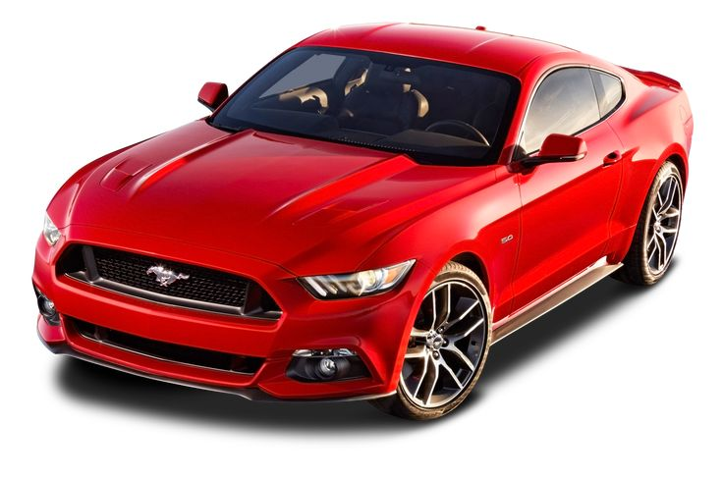

Conclusion
The Car Rental Reservation System offers an efficient, secure, and scalable solution for car rental businesses. It streamlines operations, minimizes errors, and provides a platform ready for future growth.

